Slide 1



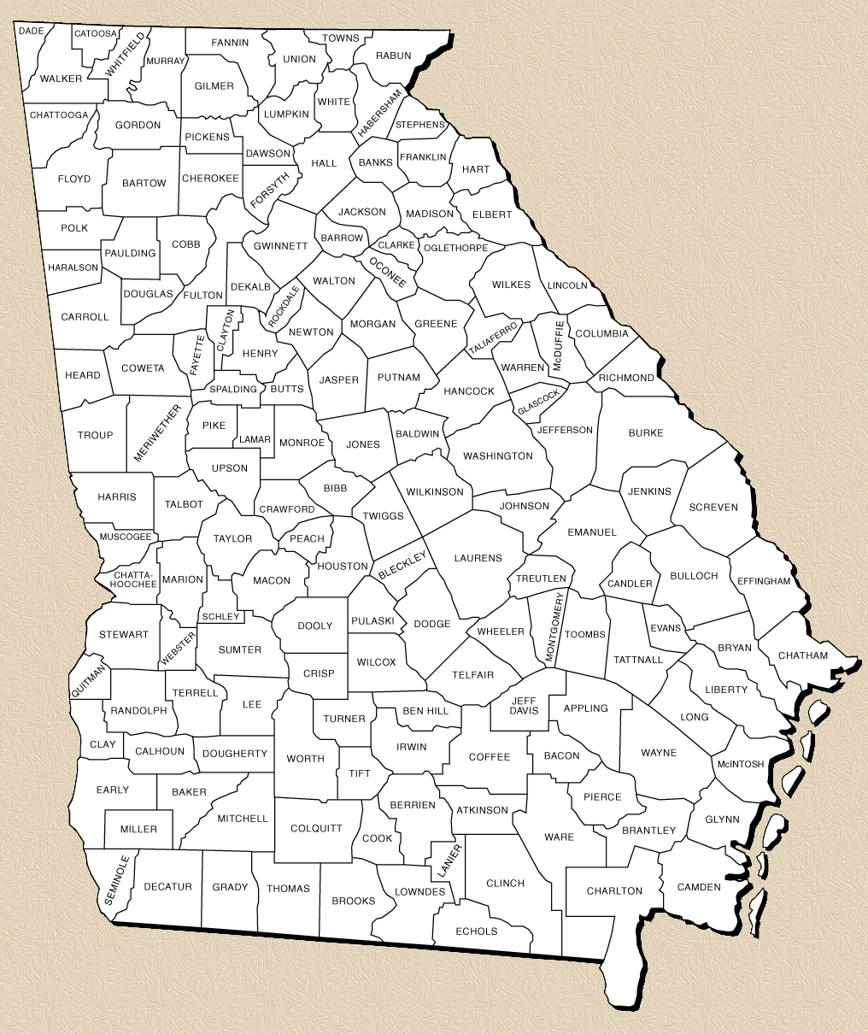


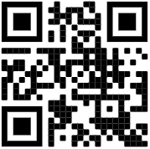








Work for Warriors Georgia (WFWGA)
Lacy Turner
Director
  770-295-9089 Lacy.p.turner.nfg@army.mil
Kyle Mbiad
Employment Coordinator 470-620-8088
Kyle@w4wga.org
Employment Coordinators are located throughout the state and are the subject matter experts in their area.
Patrick Rivers Employment Coordinator 678-788-3018
Patrick@w4wga.org
Ellis Hudson
Employment Coordinator
770-842-7375
Ellis@w4wga.org
Brandon Koutalidis Employment Coordinator 678-881-1506
Brandon@w4wga.org
Jason McCarty Employment Coordinator 678-899-9967
Jason@w4wga.org
To register for assistance, visit www.w4wga.org or contact an Employment Coordinator.
Lee Rollins
Employment Coordinator 678-788-3615
Lee@w4wga.org
Sam Middleton Employment Coordinator 678-818-5831
Sam@w4wga.org
Deployable Soldiers
Ready Families
Follow us on Social Media

